Slide 1
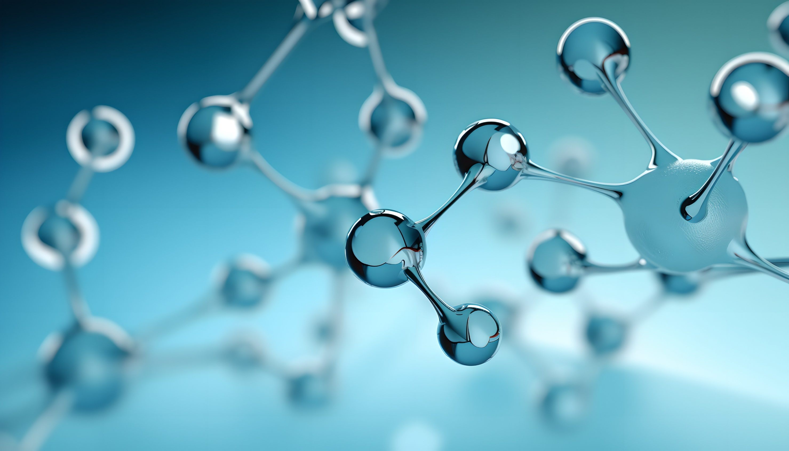
CASE
PRESENTATION
Presented by; Fatemeh Rezaeyan

Slide 2
Case Presentation;
A 22-year-old male presented to the emergency department with generalized weakness and malaise/ dizziness and syncope.. He reports 3 transient episodes of loss of consciousness lasting approximately two to three minutes, followed by spontaneous recovery, after which he returned home and rested. Following that period of rest, he experienced another episode of syncope. Over the last week of this presentation, he complains of sleeping at inappropriate times; change in sleep pattern.
Associated symptoms include;
Nausea, vomiting +/ Diaphoresis +/ no shortness of breath, no chest pain, no fever, no weight loss. He denies fever and abdominal pain.

Slide 3
Patient History;
PMH;
NO known medical history
DH;
sertraline, olanzapine
a day before admission
SH;
Recently opium addiction
FH;

Slide 4
Physical Examination;
Vital signs
HR; 36 / min regular rythem
BP; 110/70, RR; 20, Sat O2; 95%, T; 37.0°C
General appearance
Aware, oriented to time, person, place, and situation. No acute distress. Ill and toxic neg
BMI; 23.3
Head, neck;
No palpable cervical lymphadenopathy, pale and icterus – no skin lesions
Chest;
No increased work of breathing or use of accessory muscles, 3/6 systolic murmur at AV position radiates to
Abdomen;
Flat, no tenderness/rebound
No skin lesions
Extremities;
Warm and well-perfused
Clubbing +

Slide 5
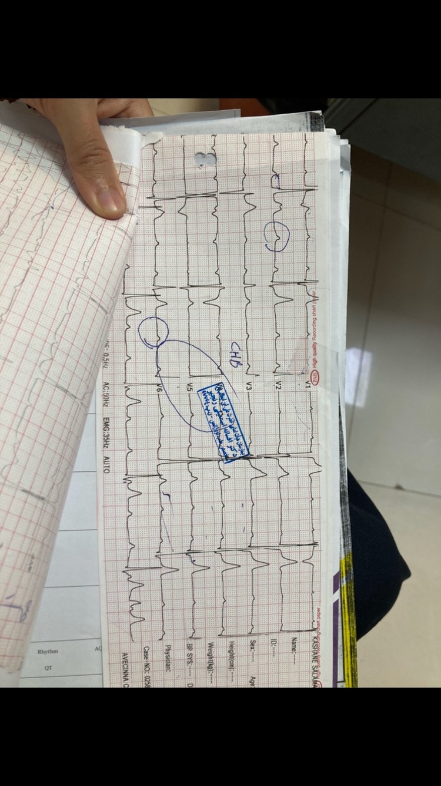

1
2
3
aVR
Avl
aVF

Slide 6
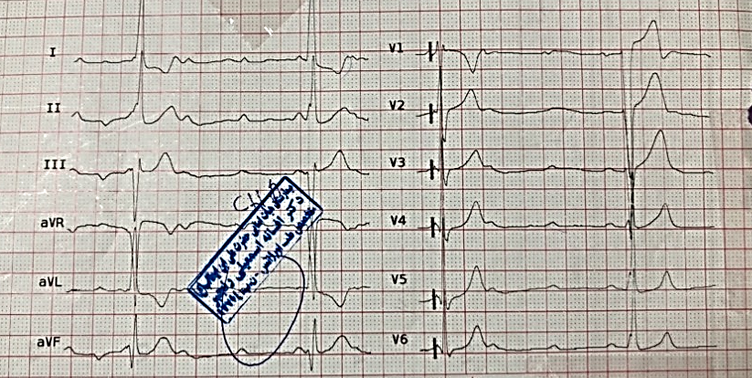

Slide 7
Laboratory Tests;
Troponin; neg
WBC; 9,300
Hb; 13.4
HCT; 38.5
MCV; 80
PLT; 268,000
BS; 112
BUN; 15
Cr; 0.86
Na; 139
K; 4.1
UA Toxicology; all Neg
Mg; 1.81
Ca; 8.6
TSH; 2.5
ESR; 13
CRP; 44
Management;
Amp Atropine, amp theophylline 200mg, monitoring

Slide 8
Management;
Amp Atropine, amp theophylline 200mg, monitoring
Echocardiography;
Mild MR
Mod AI, Mod AR
Mobile echogenic mass on the aortic valve
Via the right femoral vein, TPM was inserted into the RV
Referred for TEE, PPM

Slide 9
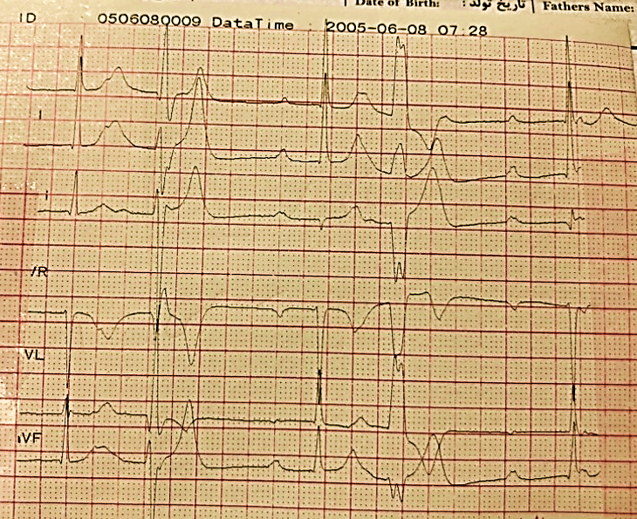
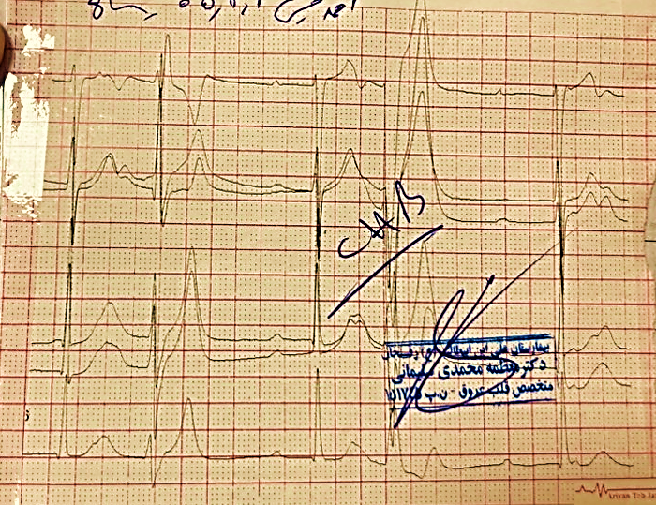

Slide 10
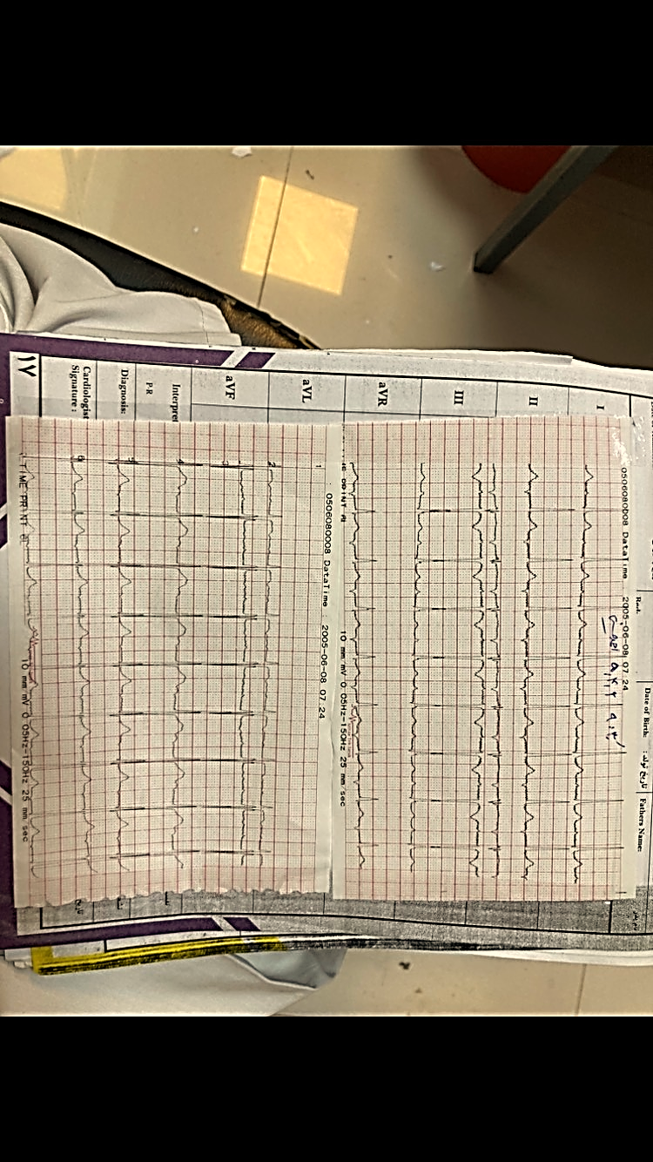

Slide 11
Referred for TEE, PPM
No mass, no indication for PPM
Discharged
…

Slide 12
Patient History;
After discharge: right knee swelling
ساختار اکوژن سایز 20 در 10 میلی متر در دیستال شریال Sfa
: شروع آپیکسابان
پس از برطرف شدن ادم و درد عدم مصرف دارو
weakness, myalgia, productive cough, coryza, anorexia, Reduce function ;
Adult cold, amoxicillin started
Weakness, fatigue, diaphoresis, night sweats, fever,
Ill, left lower Extremity edematous, tense, ache
…

Slide 13
Admission;
Echocardiography;
Laboratory Tests;
Mild MR
Mod AI, Mod AR
Mobile echogenic mass on the aortic valve
WBC; 9,800
Hb; 12.8
HCT; 34.5
MCV; 79
PLT; 313,000
Neu; 49.8
Lymph; 39.9
Mono; 8.1
Eosi; 2.2
ANA; 0.02
RF; +3
Wright agglutination,
Coombs wight; neg
ESR; 50 (13)
CRP; 80
Blood culture; negative
PH; 7.38
BE; 5
PCO2; 31.9
HCO3; 18.7

Slide 15
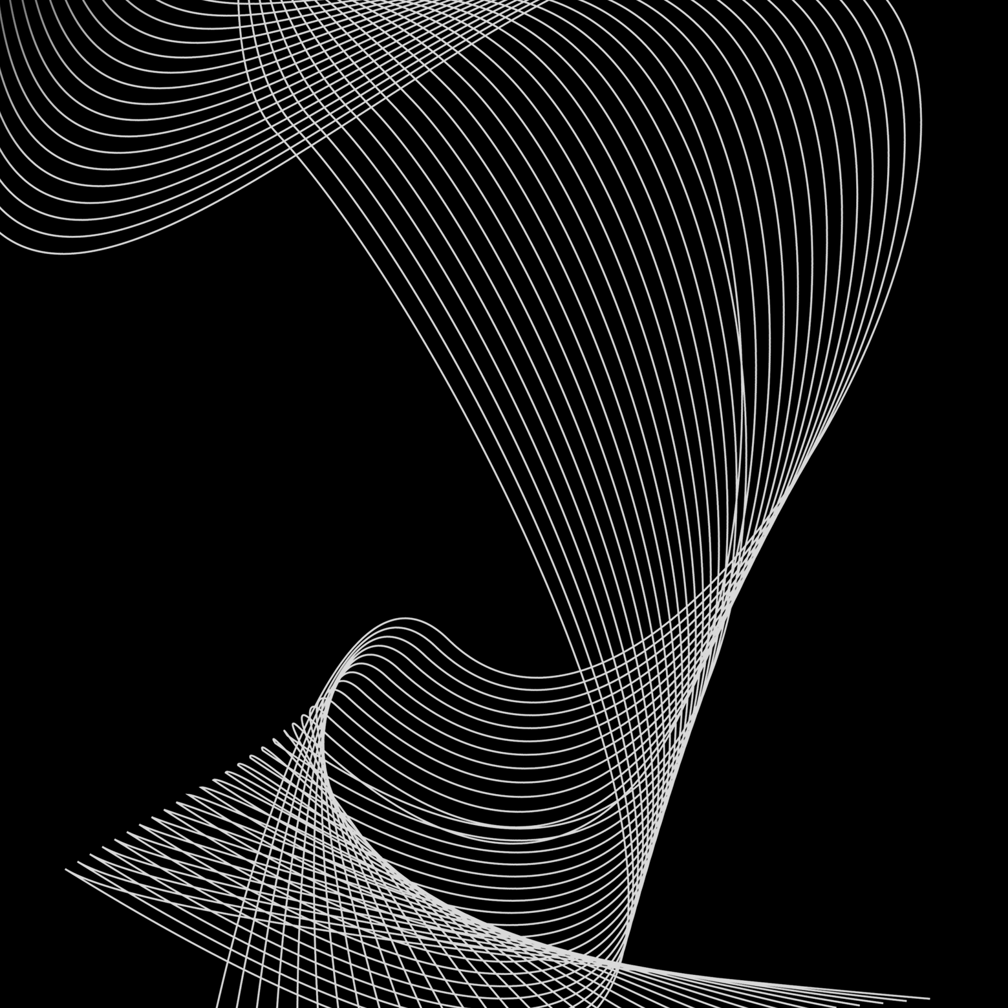
Thank you

